Slide 1
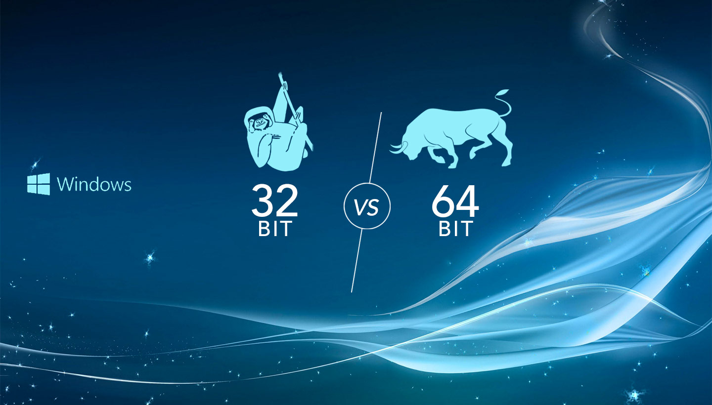
32 and 64 bit systems

Slide 2
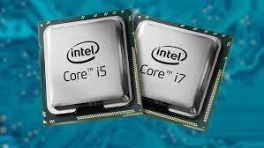
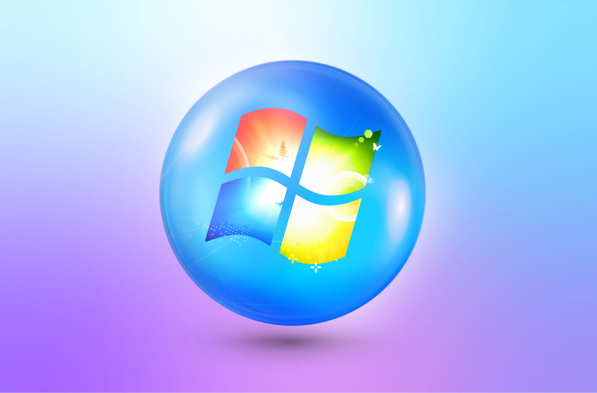
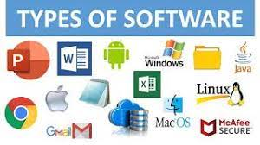
32bit and 64bit hardware and software
Hardware and software comes in 32bit and 64bit.
We have 32 and 64bit processors.
We have 32 and 64bit operating systems.
We have 32 and 64 bit softwares.

Slide 3
32 bit and 64 bit processors
The main difference between them is to handle RAM Memory.
RAM
Harddisk
Processor

Slide 4
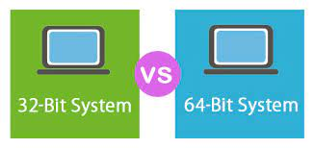
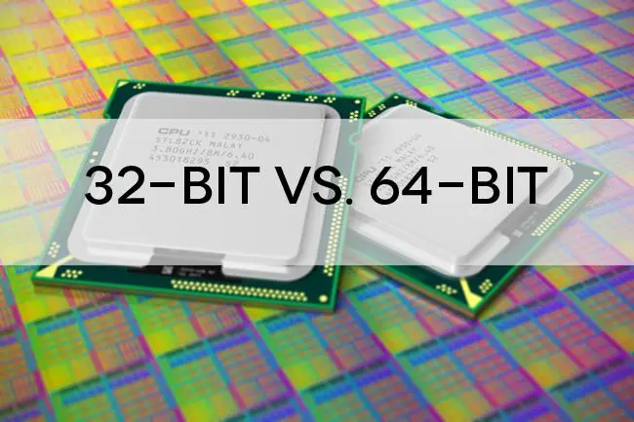
32 and 64 bit processors
32bit processors only use 4GB not more than this.
64bit processors uses 16Exabyte.
16 Exabyte's equal to 1,000 Petabytes
An extraordinarily large unit of digital data, one Exabyte (EB) is equal to 1,000 Petabytes
or one billion gigabytes (GB). Some technologists have estimated that all
the words ever spoken by mankind would be equal to five Exabyte's.

Slide 5
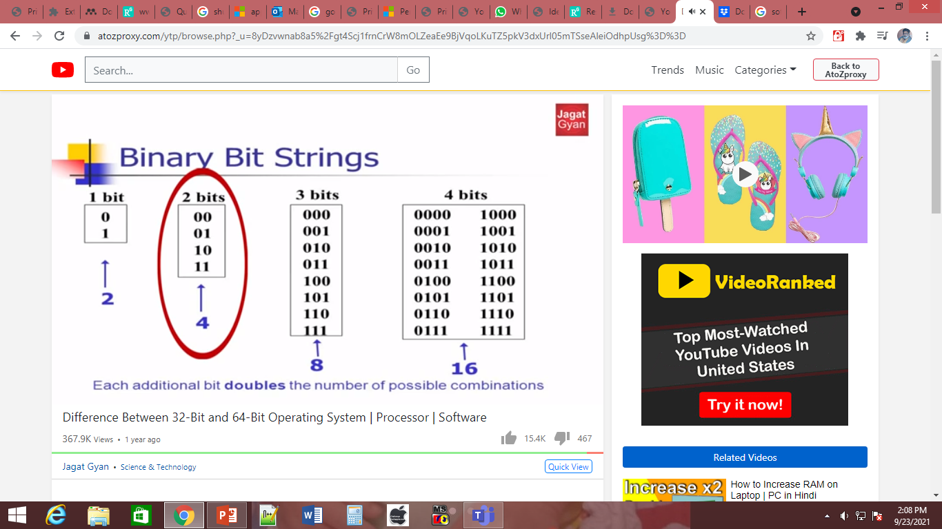

Slide 6

Who introduce 64bit processor?
The AMD Opteron processor for servers and workstations,
which extends the x86 instruction set architecture (ISA) to 64-bit computing,
is also the first processor in a new class of computing called AMD64.
The first processor to implement Intel 64 was the multi-socket processor Xeon code-named Nocona in June 2004.
In contrast, the initial Prescott chips (February 2004) did not enable this feature.

Slide 7
Examples of 64-bit processors
Below is a list of examples of 64-bit computer processors.
AMD Opteron, Athlon 64, Turion 64, Sempron, Phenom, FX, and Fusion.
All Intel Xeon processors since the Nocona released in June 2004.
Intel Celeron and Pentium 4 processors since Prescott.
Intel Pentium dual-core, Core i3, Core i5, and Core i7 processors.

Slide 8
32bit processors
Intel Pentium processors and early AMD processors were 32-bit, which means the operating system and software work with data units that are 32 bits wide.

Slide 9
32& 64 bit Operating systems
32bit
A 32-bit system can access 2³² memory addresses, i.e 4 GB of RAM
64bit
Using 64-bit one can do a lot in multi-tasking, user can easily switch between various applications without any windows hanging problems.
Gamers can easily play High graphical games like Modern Warfare, GTA V, or use high-end software like Photoshop or CAD which takes a lot of memory since it makes multi-tasking with big software, easy and efficient for users.
However upgrading the video card instead of getting a 64-bit processor would be more beneficial.

Slide 10
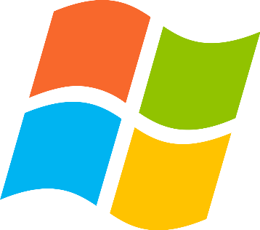
32 bit Operating System
Windows 95, 98, and XP are all 32-bit operating systems. ...
It can only have a 32-bit version of an operating system installed.

Slide 11
64Bit Operating System
There are many operating systems capable of running on 64-bit architecture,
including Windows XP, Windows Vista, Windows 7, Windows 8, and Windows 10.
However, 64-bit versions of Windows XP and Vista were far less common when they were popular.
Windows Server 2008 R2, which is the first 64-bit only server operating system.
Nearly 90 percent of today's Android devices deploy a 64-bit capable version of the OS

Slide 12
32 bit and 64 bit softwares
Read about this

